Slide 1

Pharmacy Database Design
Presented by:
Shahd Mohamed 202100069
Salwa Hossam 202100357
Salma Ashour 202100420
Sama Kassem 202101813
Alaa Mohamed 202102999
Supervised by:
Dr. Ahmed Younis

Slide 2
Agenda
Business Scenario
Conceptual Data Model
Key Based Data Model
Many to many Relations

Slide 3
Business Scenario

Slide 4
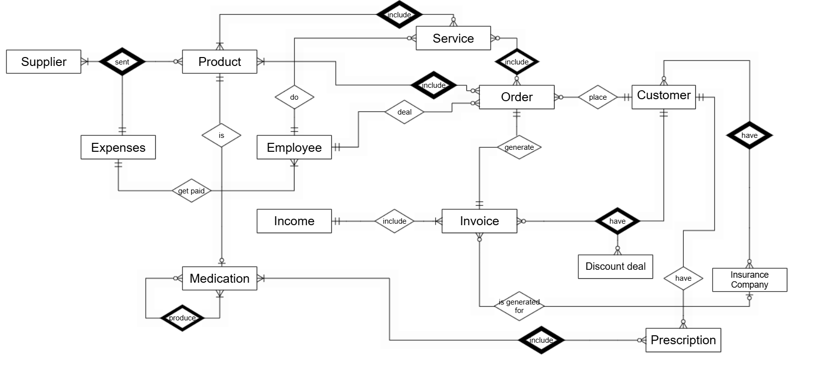
Conceptual Data Model

Slide 5
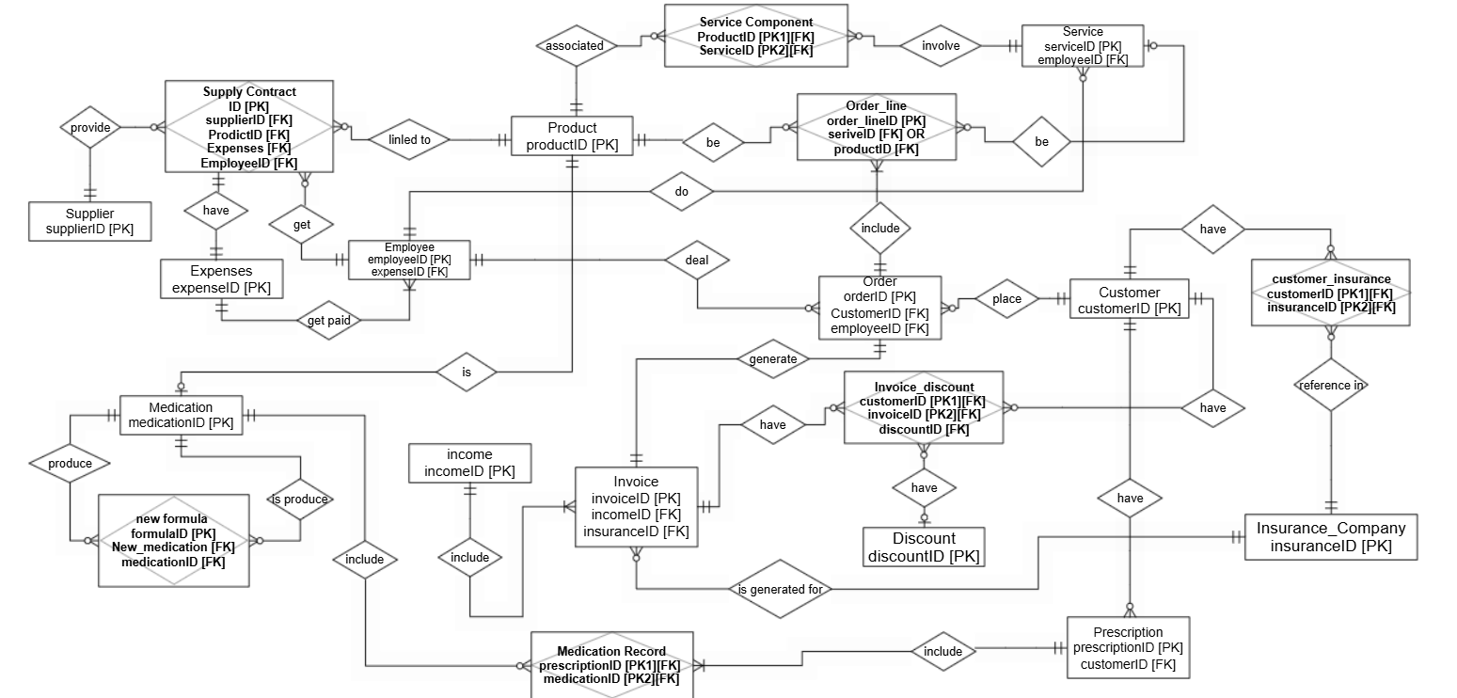
Key Based Data Model

Slide 6
Many to many relationships

Slide 7
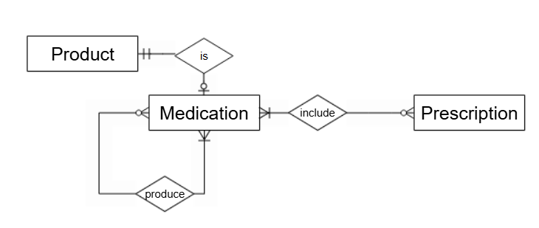
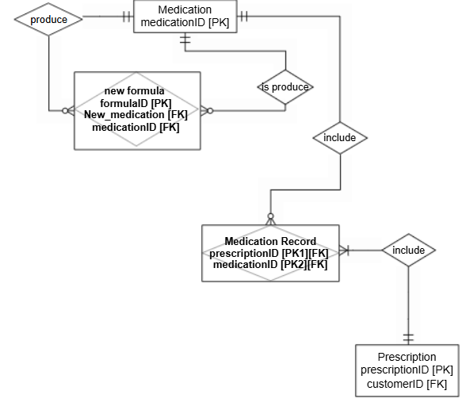
Medication relationships
Conceptual view
Medication (recursive relation)
Medication may produce zero or more medications
Medication - prescription
Medication may include in zero or more Prescription.
Prescription must include one or more Medication..
Key based view

Slide 8
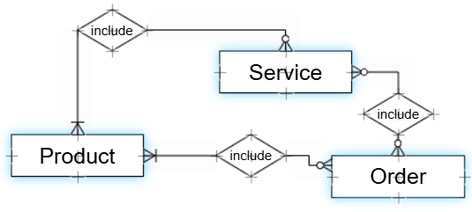
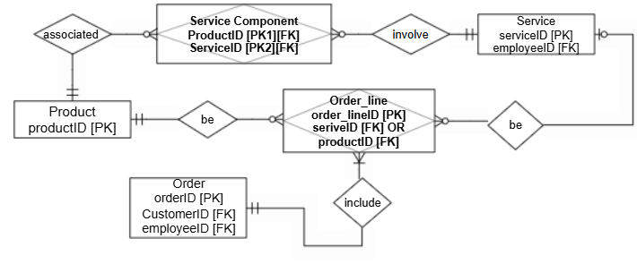
Service – product – order relationships
Conceptual view
product – order
Product may be contained in zero or more orders.
Order must contain one or more products.
Service – order
Service may generate zero or more Order.
Order may be generated by zero or more services
Service – product
Product may be included in zero or more services.
Service must include one or more products.
Key based view

Slide 9
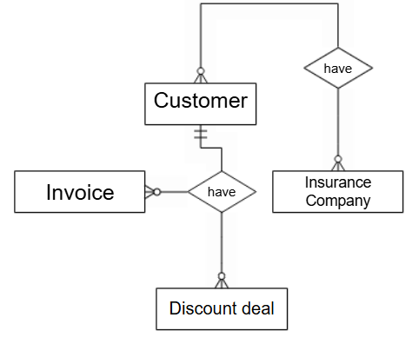
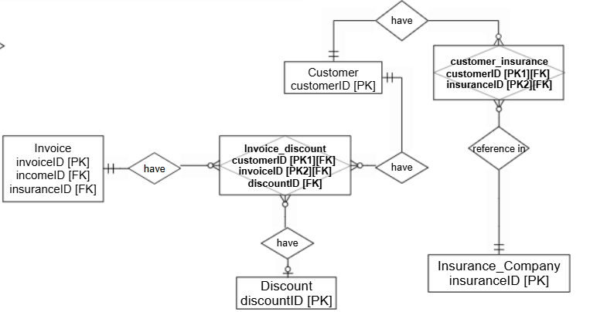
Customer relationships
Customer - Insurance
Customer may have zero or more insurance.
Insurance may apply to zero or more customers.
Conceptual view
Customer – invoice - discount
Customer may have zero or more invoices.
Invoice must have one customer.
Discount may apply to only one invoice.
Key based view

Slide 10
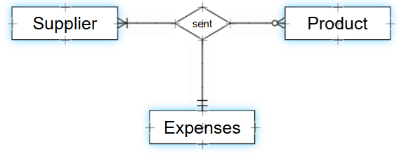
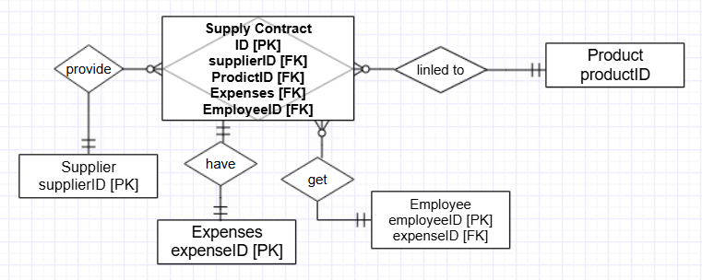
Supply contract relationships
Conceptual view
Key based view
Supplier – Product - expenses
Supplier may send zero or more products.
Product must be sent by one or more suppliers.
Supplier must get Expenses on the products supplied

Slide 11
Q&A Session

Slide 12

Thank you

